Slide 1
Lowest Common Multiples
Get ready to clap!

Slide 2
EQ: How can we find lowest common multiples mentally and with a calculator?
Split class into two groups
Group1 will skip count to a beat on 2
Group 2 will skip count to the same beat on 3

Slide 3
Which numbers do both groups say?
These numbers are common multiples of 2 and 3
The lowest common multiple will be the first one.

Slide 4
Split your class into 4 groups
Group 1 skip count in 2s
Group 2 skip count in 3s
Group 3 skip count in 4s
Group 4 skip count in 5s
Up until 100
What are the common multiples?
What is the lowest common multiple?

Slide 5
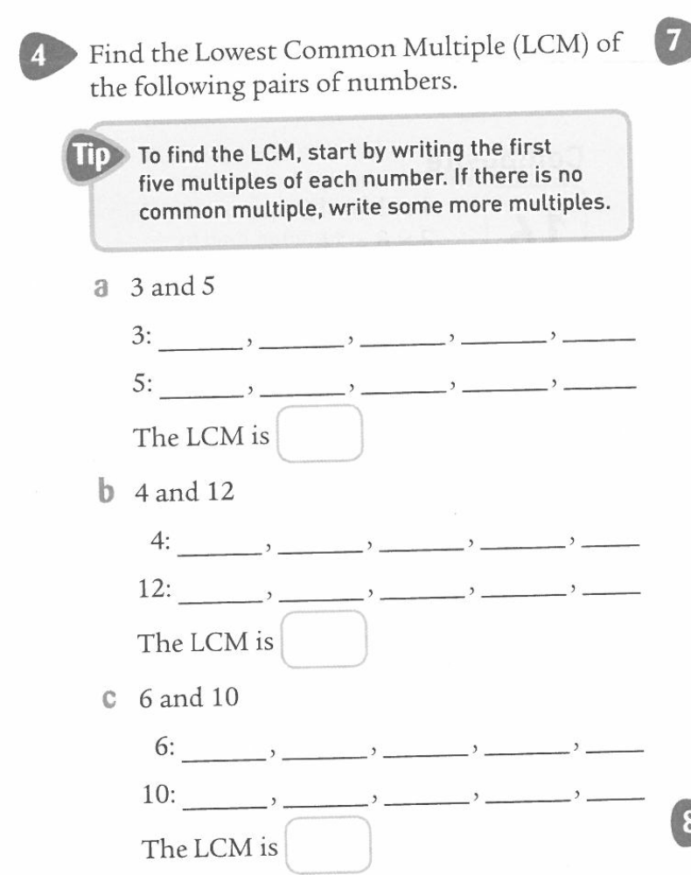
Do this on the left hand side of the page.

